Slide 1
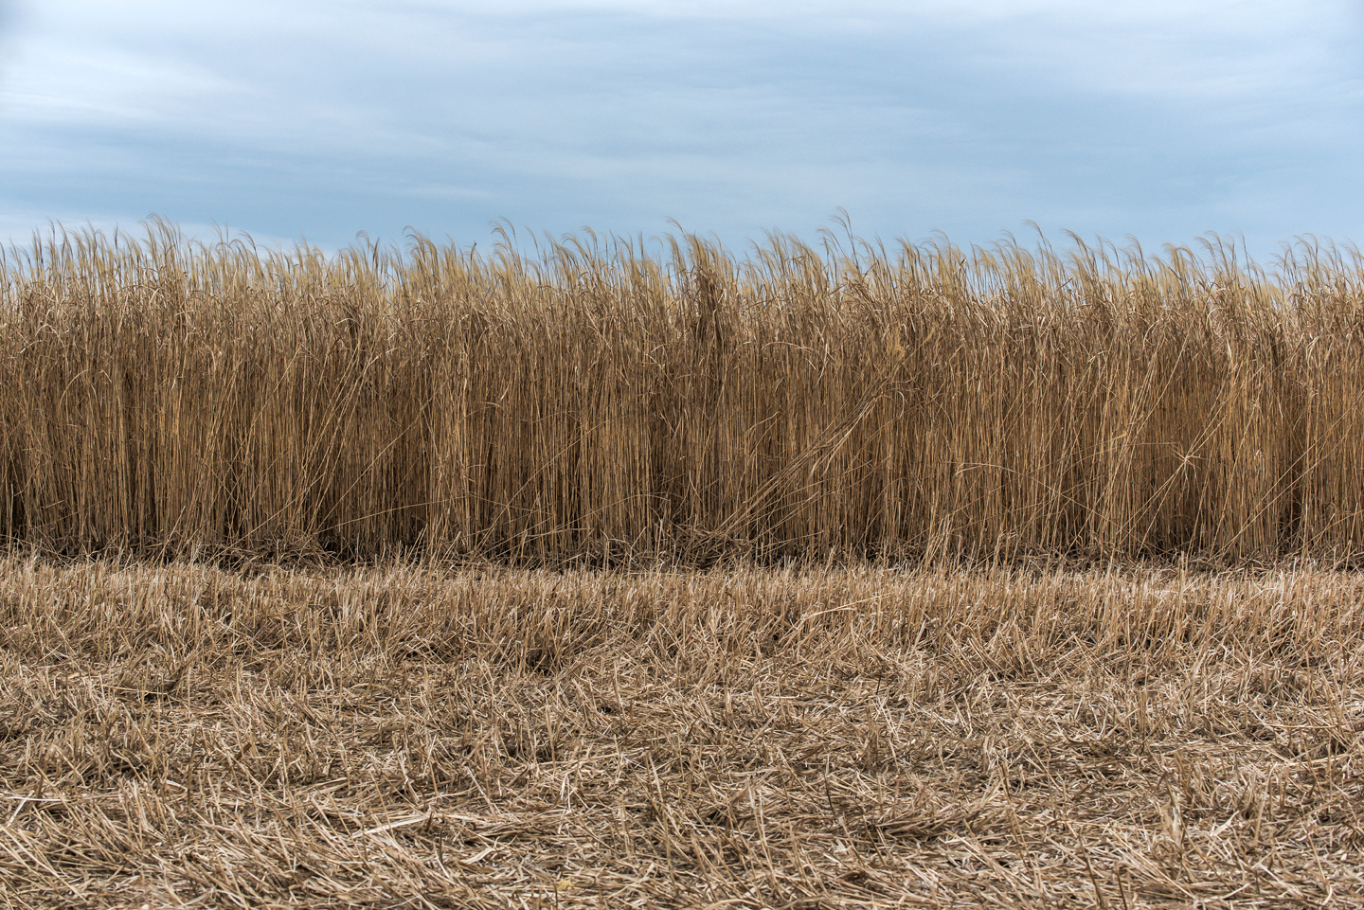
Real World Miscanthus is a non-invasive plant. It does not produce viable seed and will only spread 4-6" per year through new shoots from its roots.
Available at www.realworldwildlifeproducts.com in early 2020

Slide 2
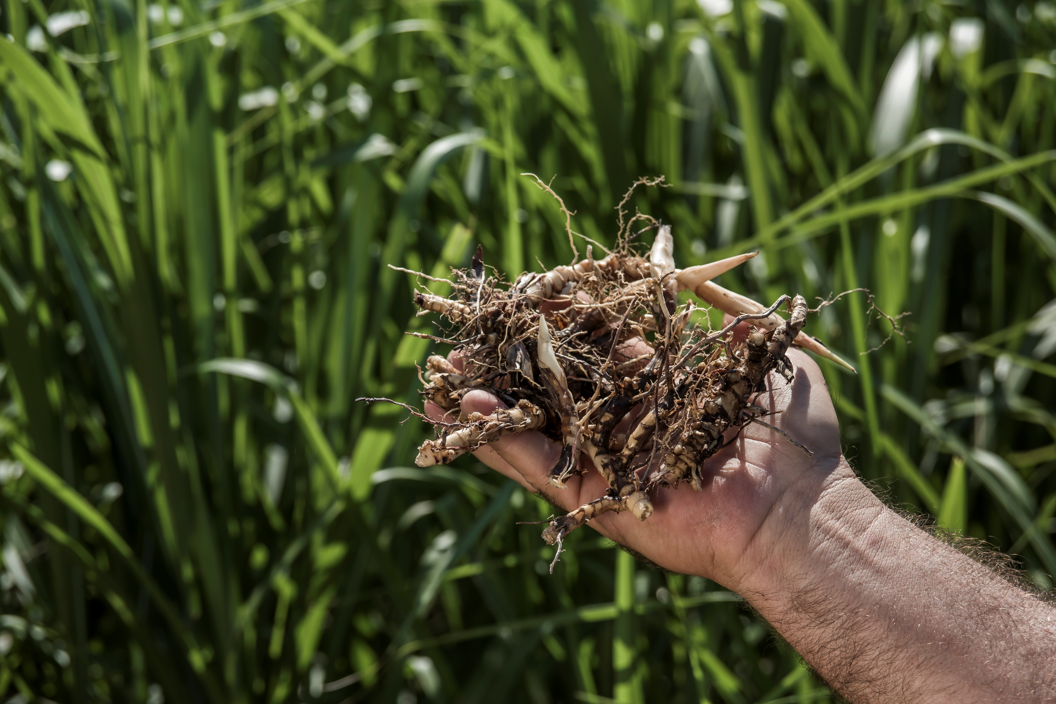
Real World Miscanthus must be propagated by planting small pieces of roots called rhizomes.
Available at www.realworldwildlifeproducts.com in early 2020

Slide 3
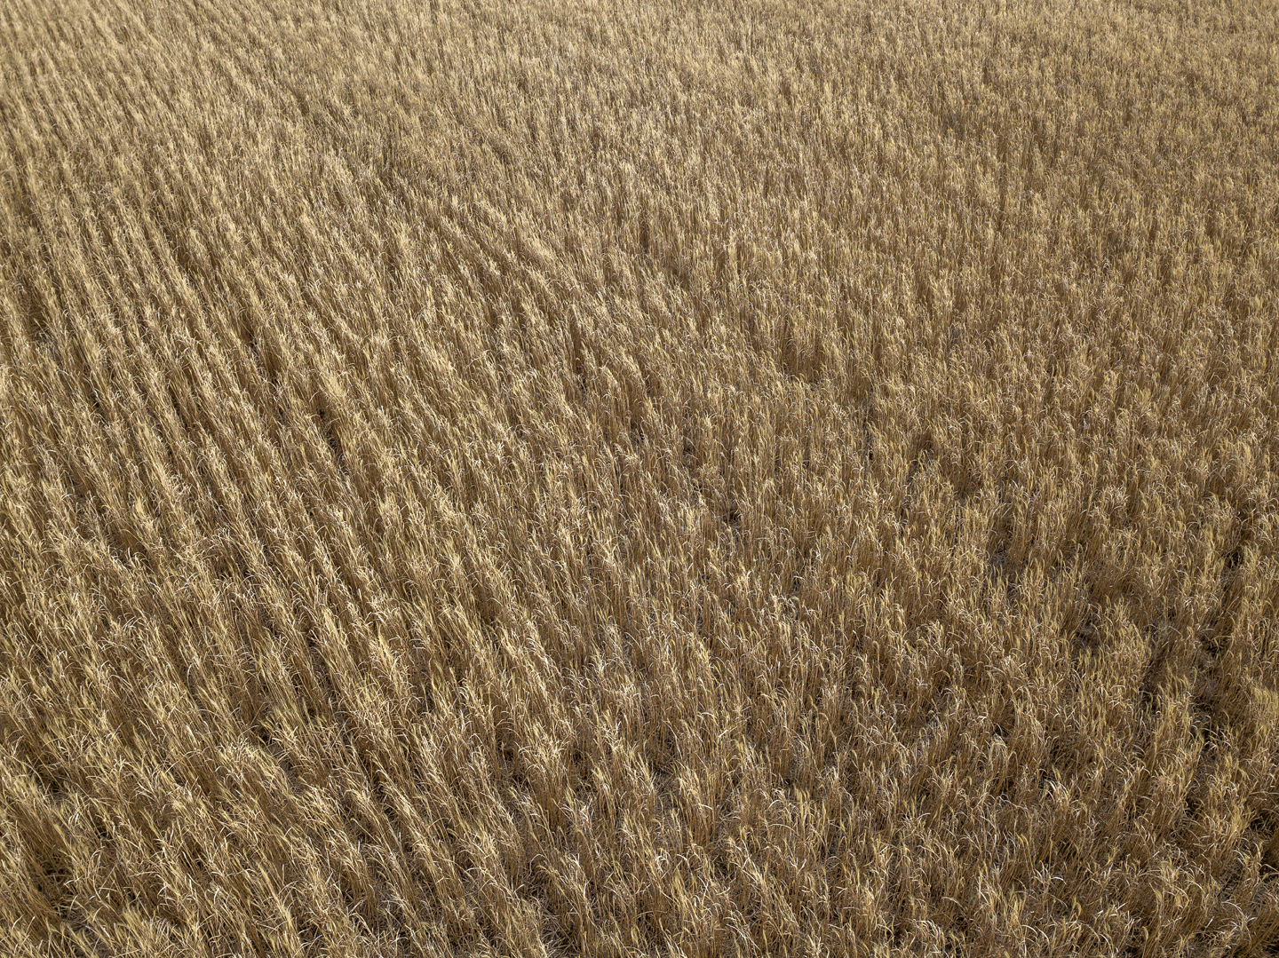
Real World Miscanthus rhizomes should be planted 18" apart in rows that are 18-24" apart. Plant 3-5 rows for a great screen.
Available at www.realworldwildlifeproducts.com in early 2020

Slide 4
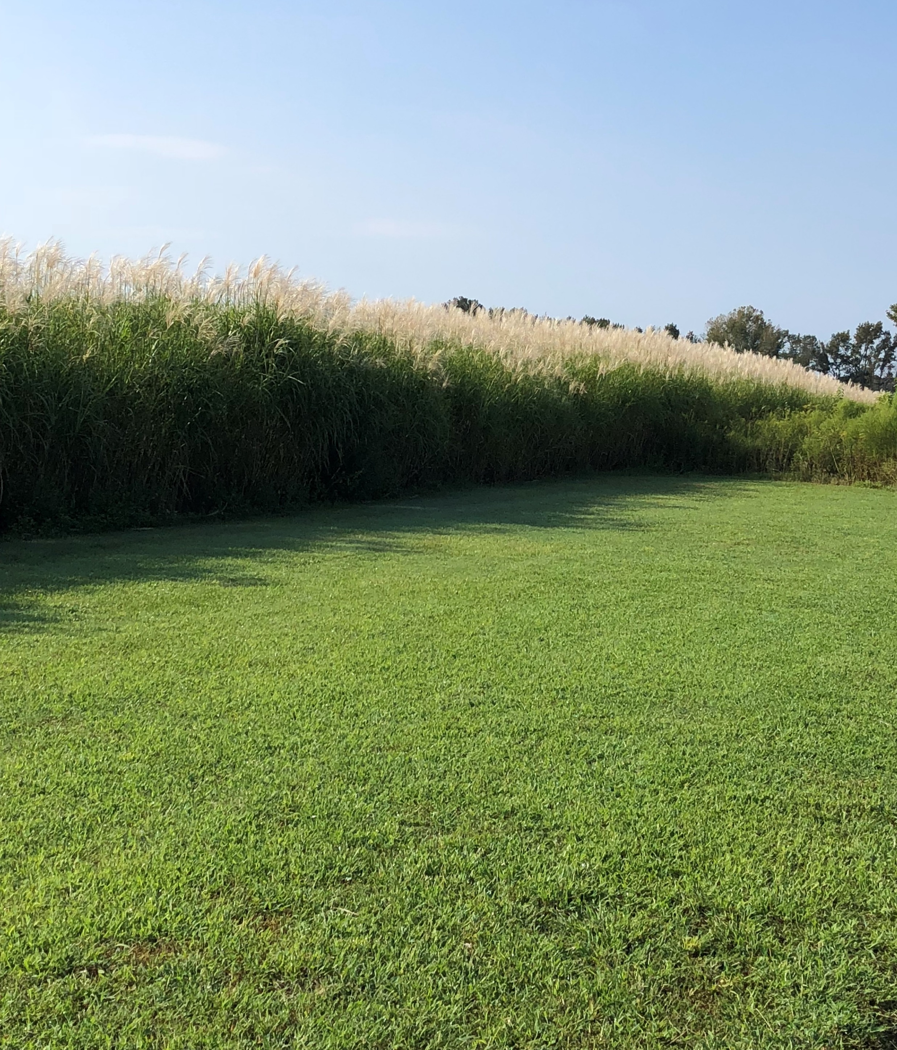
Real World Miscanthus comes back year after year so you only plant it one time.
Available at www.realworldwildlifeproducts.com Late December 2019.

Slide 5
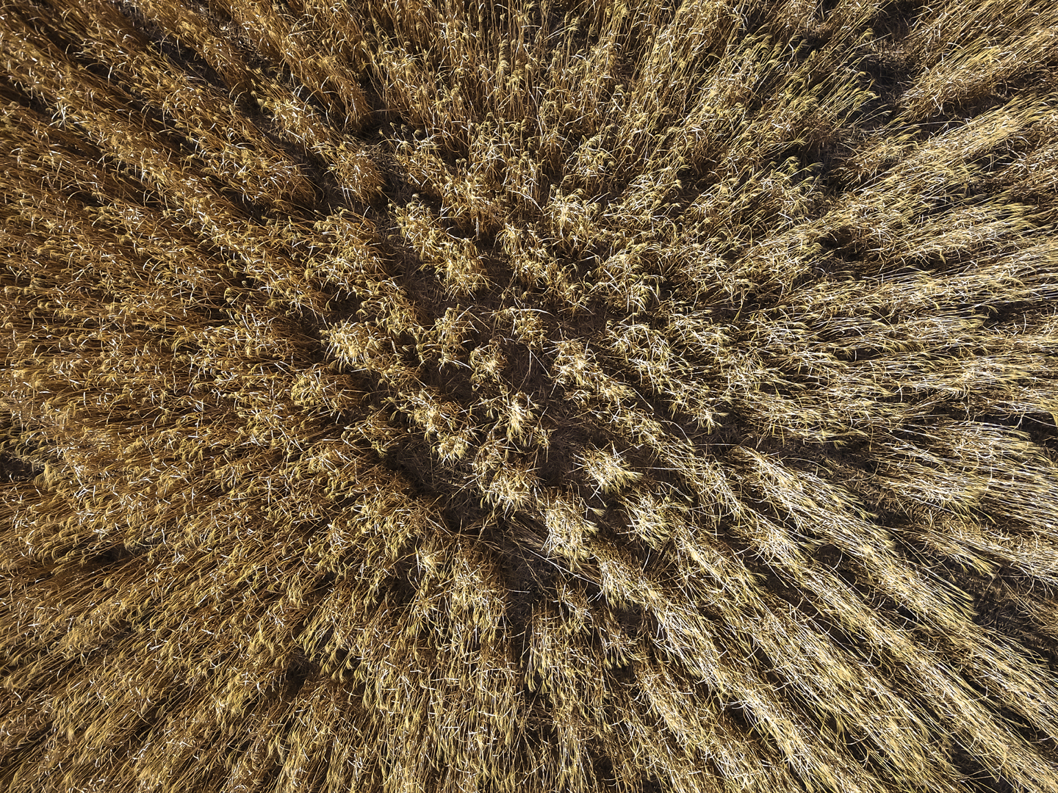
Real World Miscanthus is a non-invasive plant. It does not produce viable seed and will only spread 4-6" per year through new shoots from its roots.
Available at www.realworldwildlifeproducts.com Late December 2019.

Slide 6
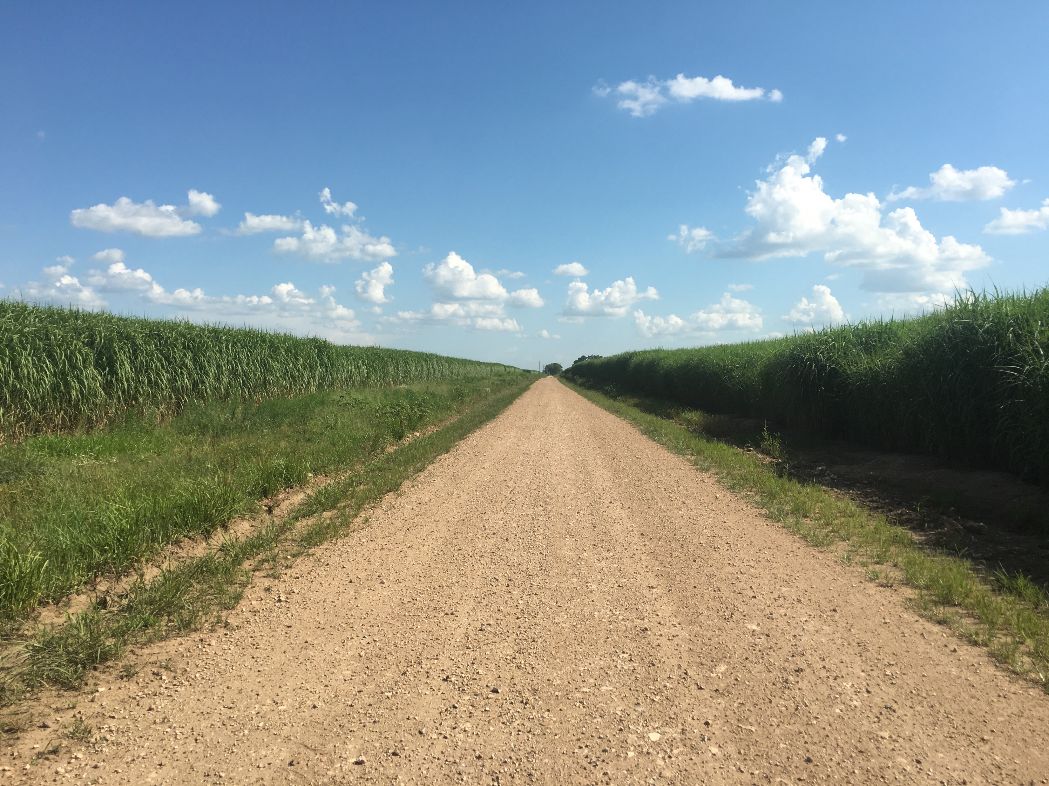
Real World Miscanthus is a game changer for areas where you need to block line of sight from roadways, houses, and parking locations.
Available at www.realworldwildlifeproducts.com Late December 2019.

Slide 7
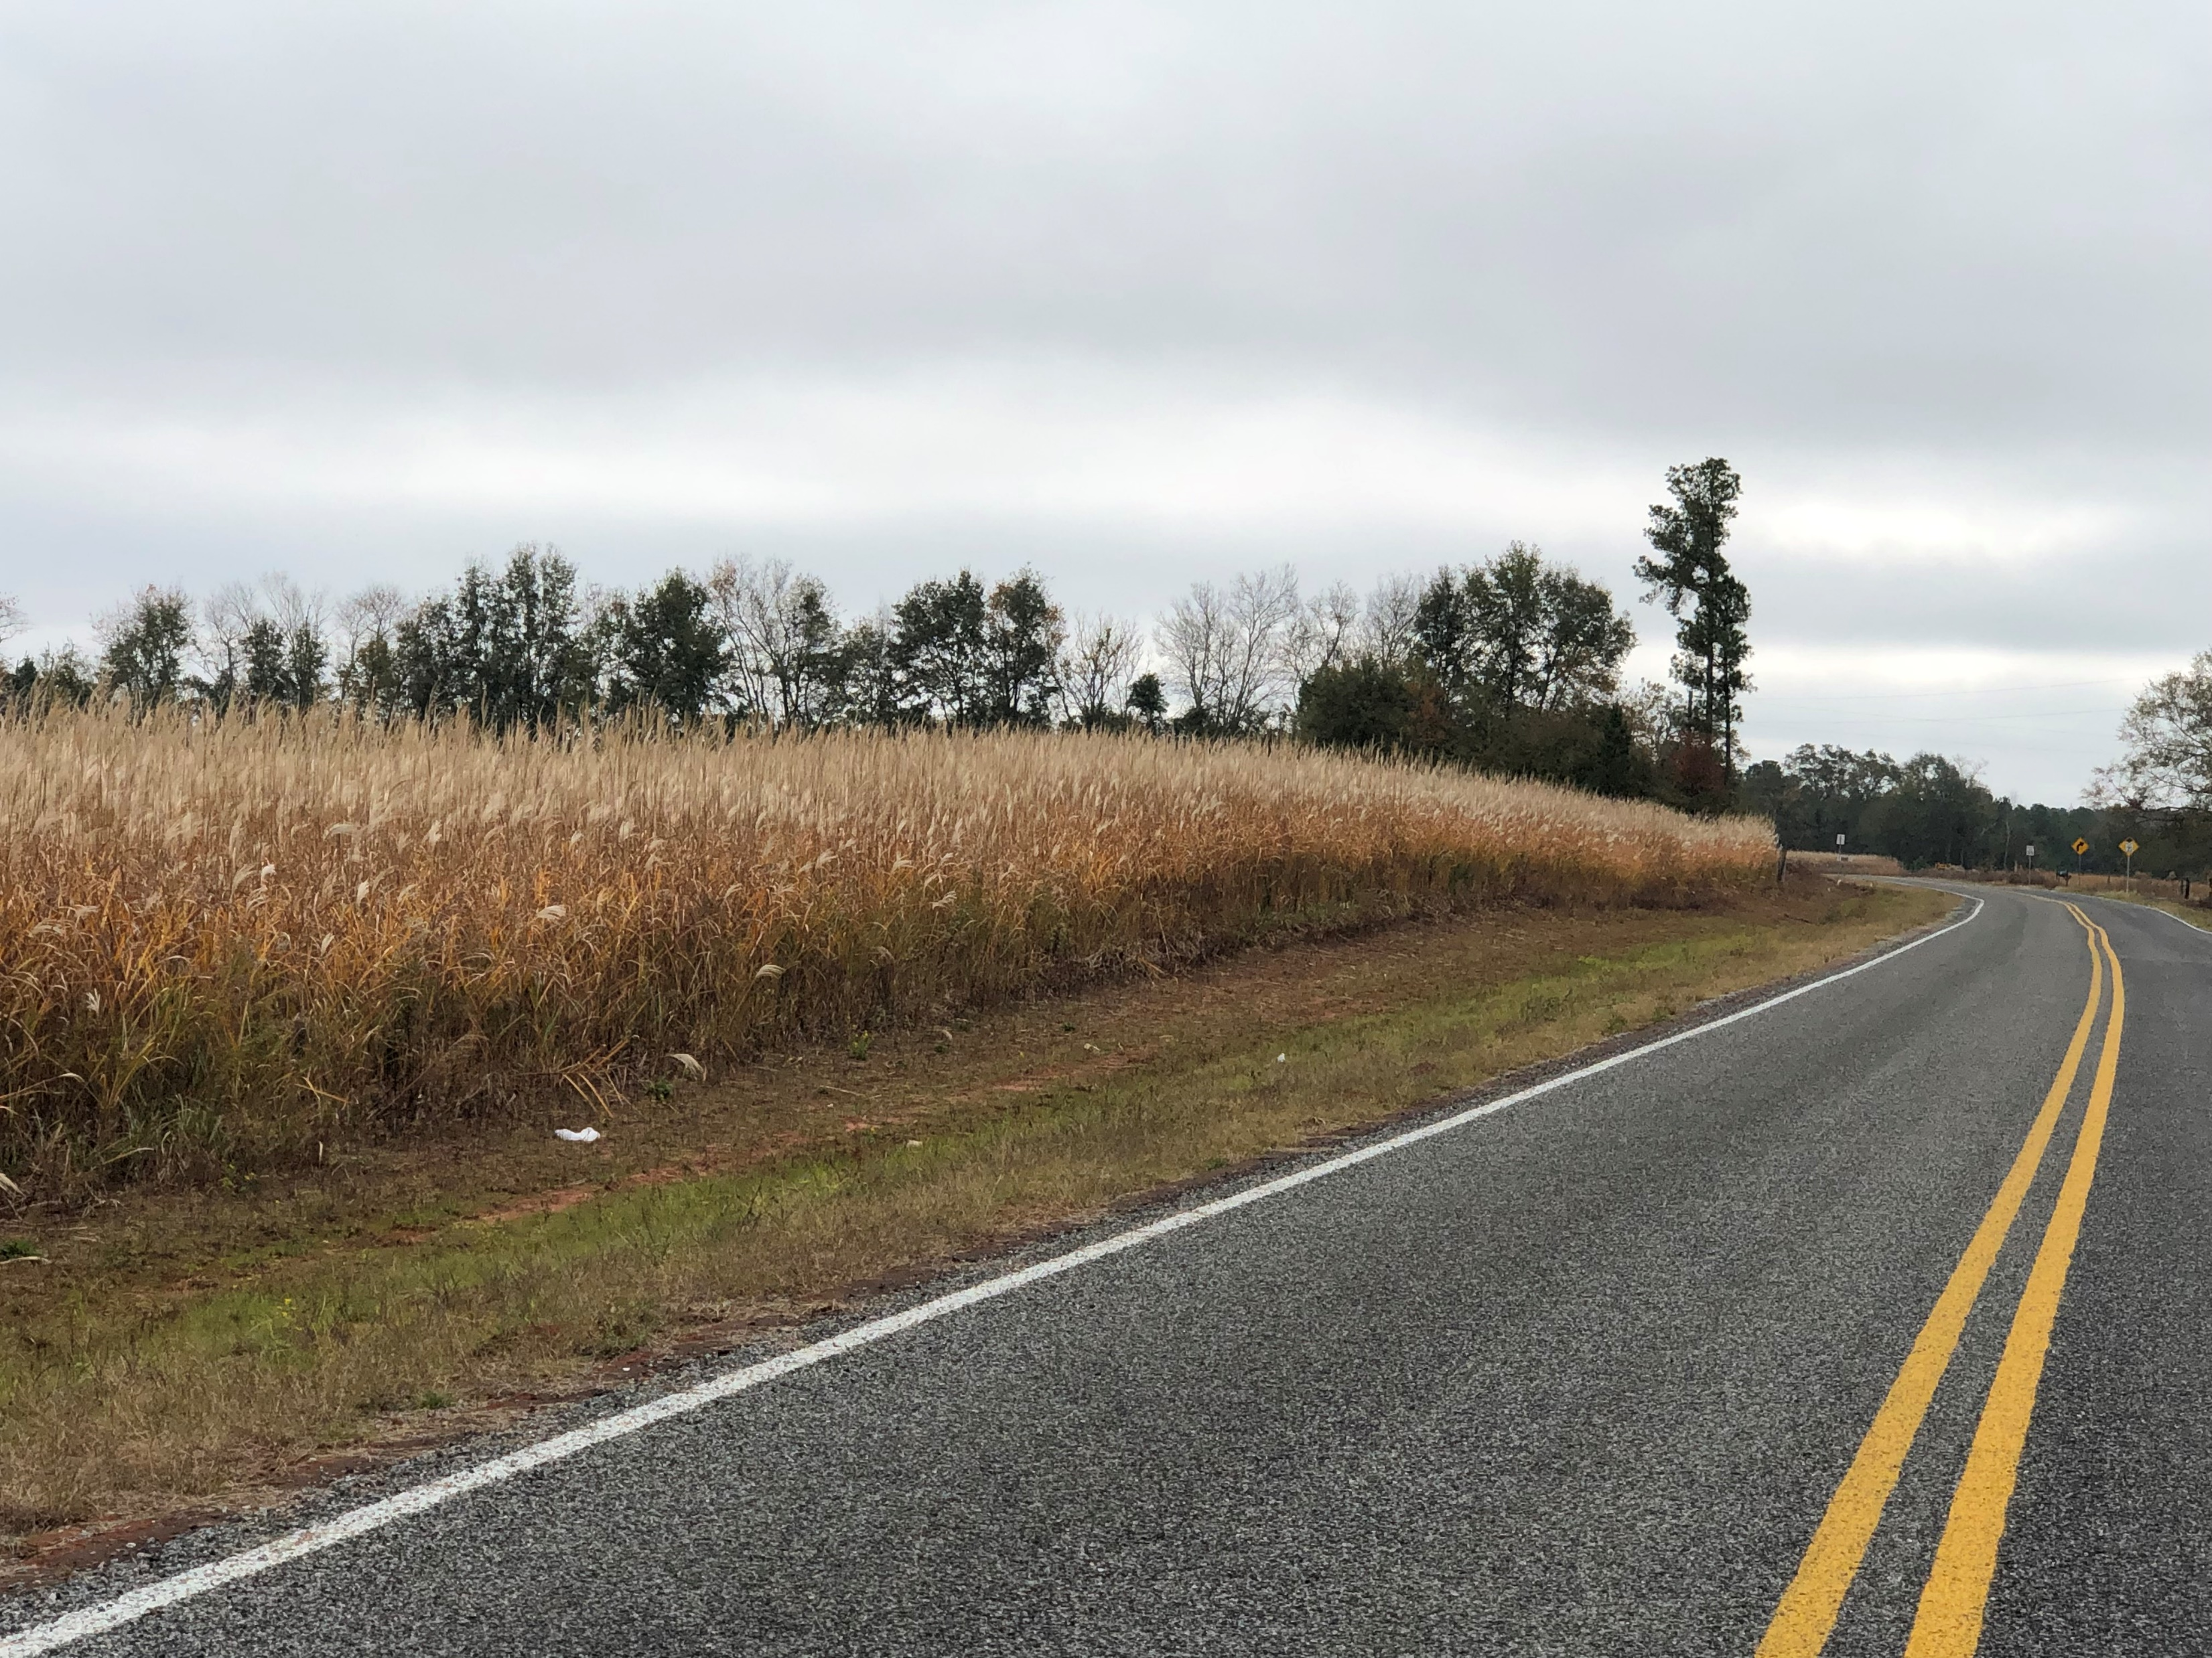
Perfect for Roadside Applications. Block views of your food plot, stand location, or farm from people who may glass or illegally hunt from roadways.
Available at www.realworldwildlifeproducts.com Late December 2019.

Slide 8
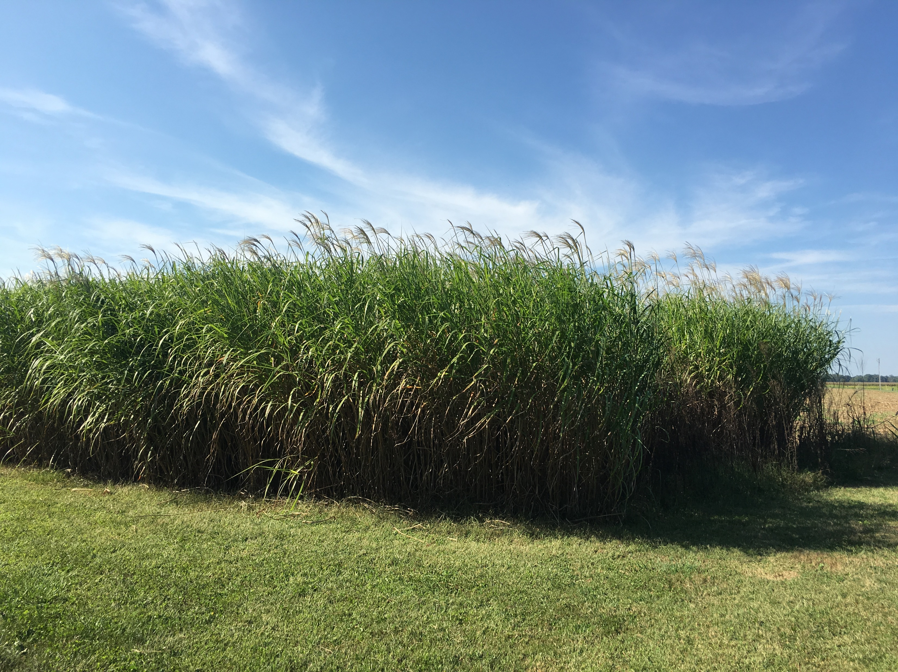
Real World Miscanthus is different than other varieties. Chosen specifically for the leafy characteristics that provide thick wall to block all line of site.
Available at www.realworldwildlifeproducts.com Late December 2019.

Slide 9
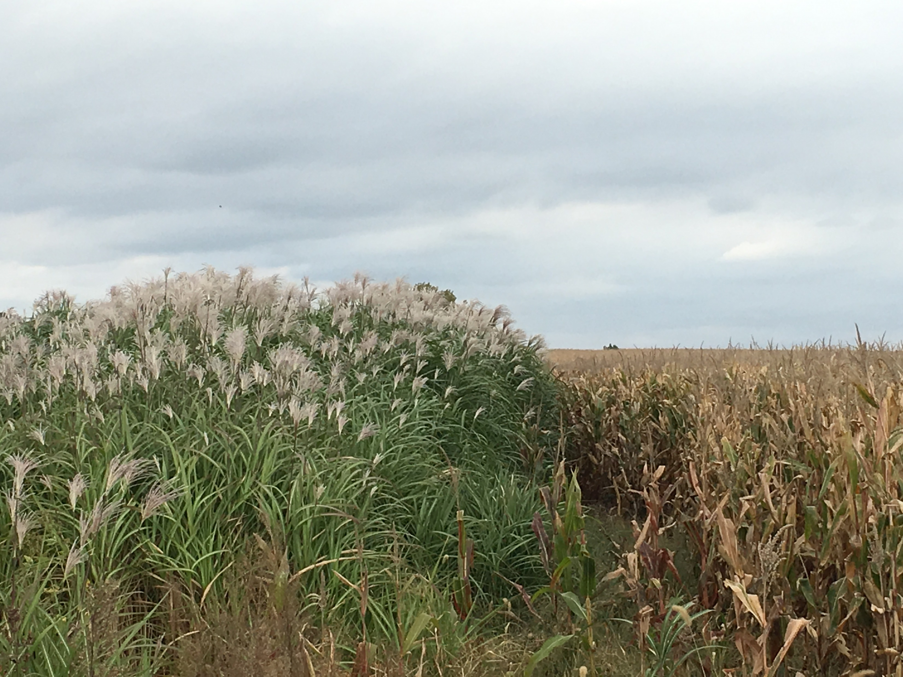
Real World Miscanthus provides thicker and taller screen than field corn. Will stand strong though harsh late season weather. The wall that wont fall down!
Available at www.realworldwildlifeproducts.com Late December 2019.

Slide 10
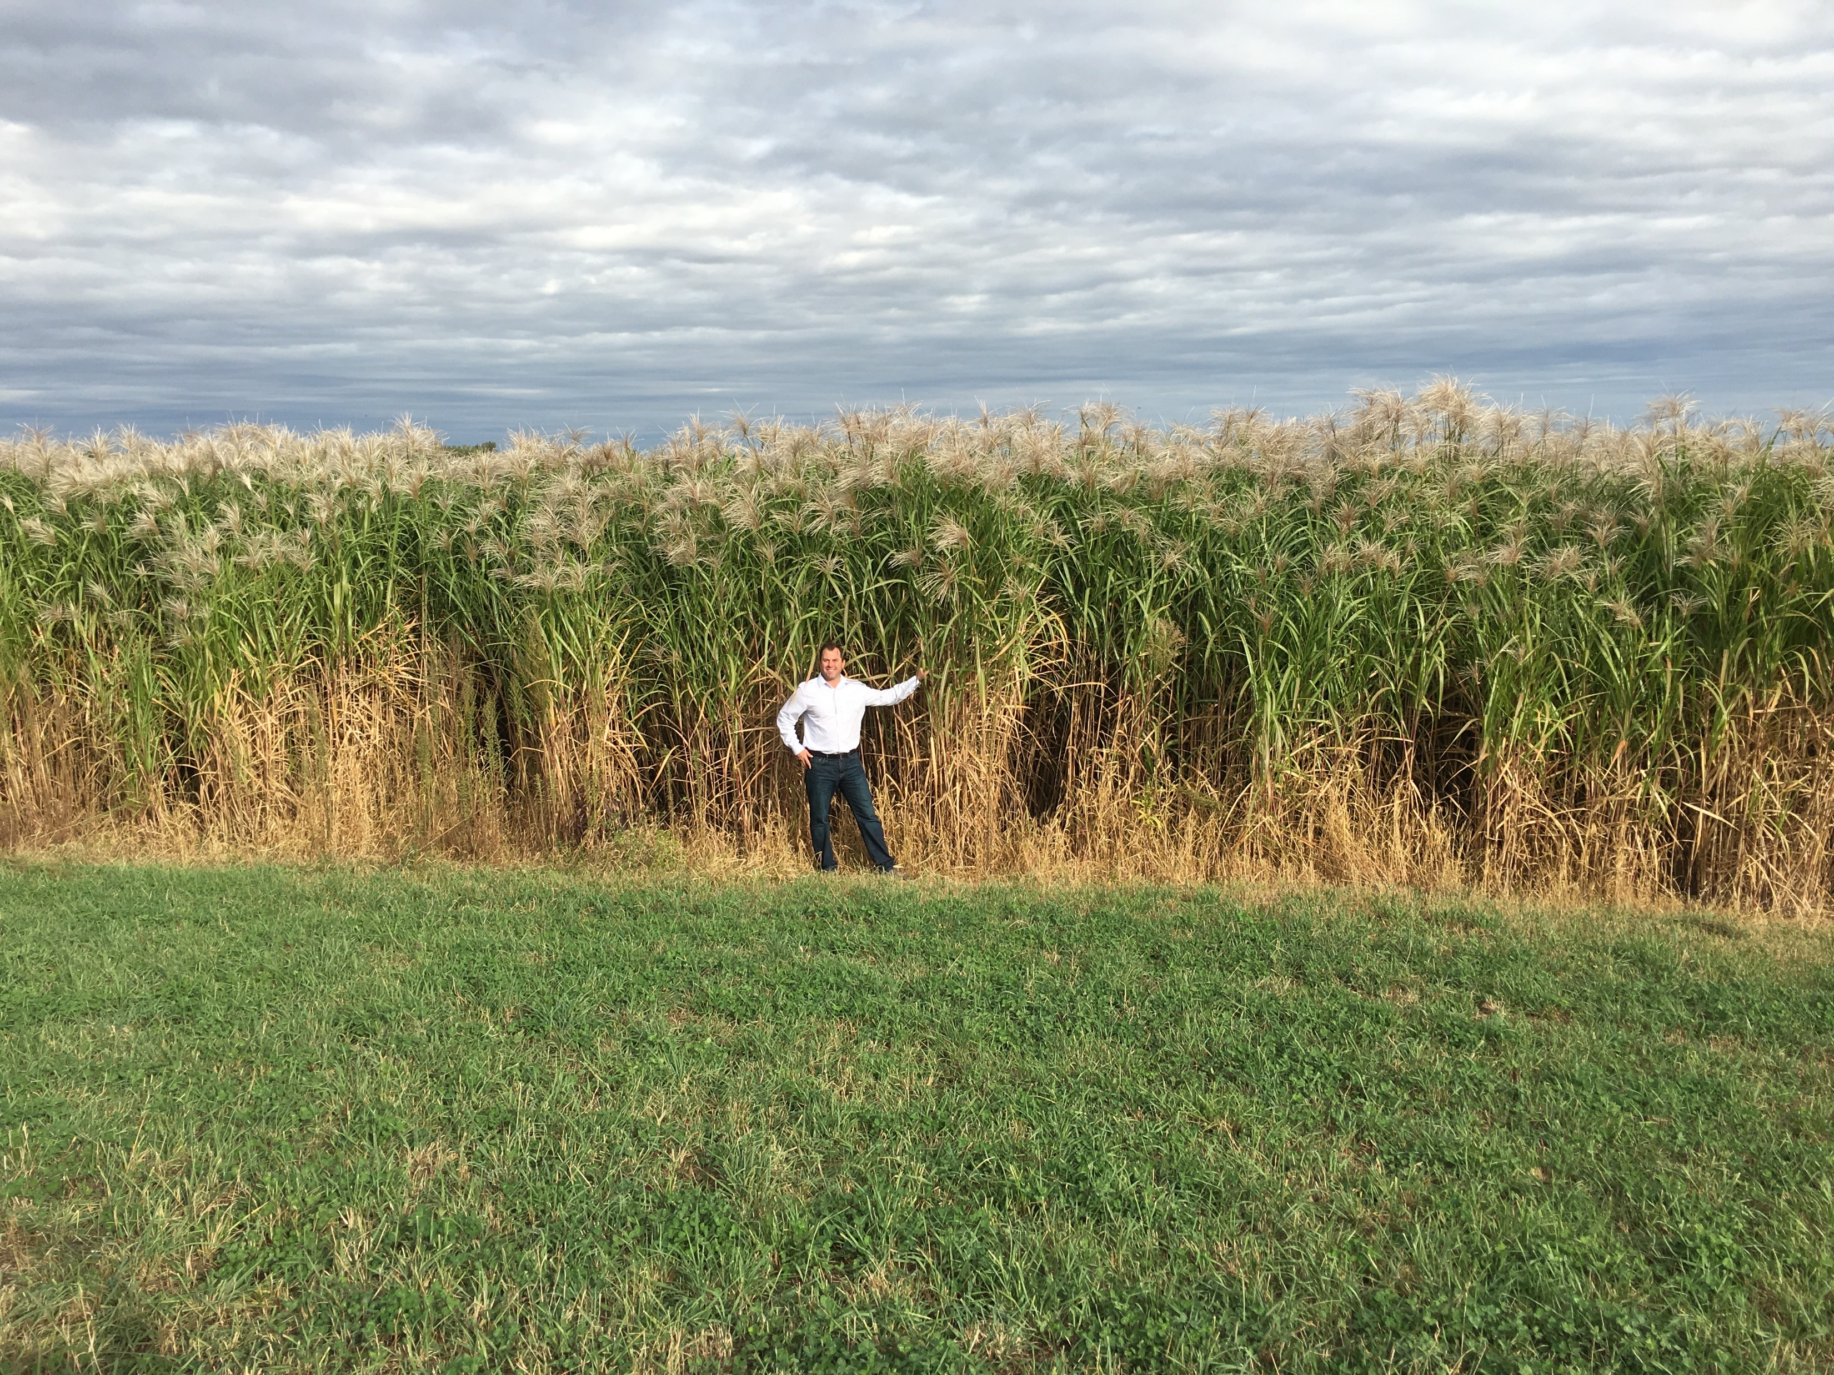
Real World Miscanthus was specifically chosen for its leafy thick characteristics which provide hunters and land managers with game changing screen for different applications.
Available at www.realworldwildlifeproducts.com Late December 2019.

Slide 11
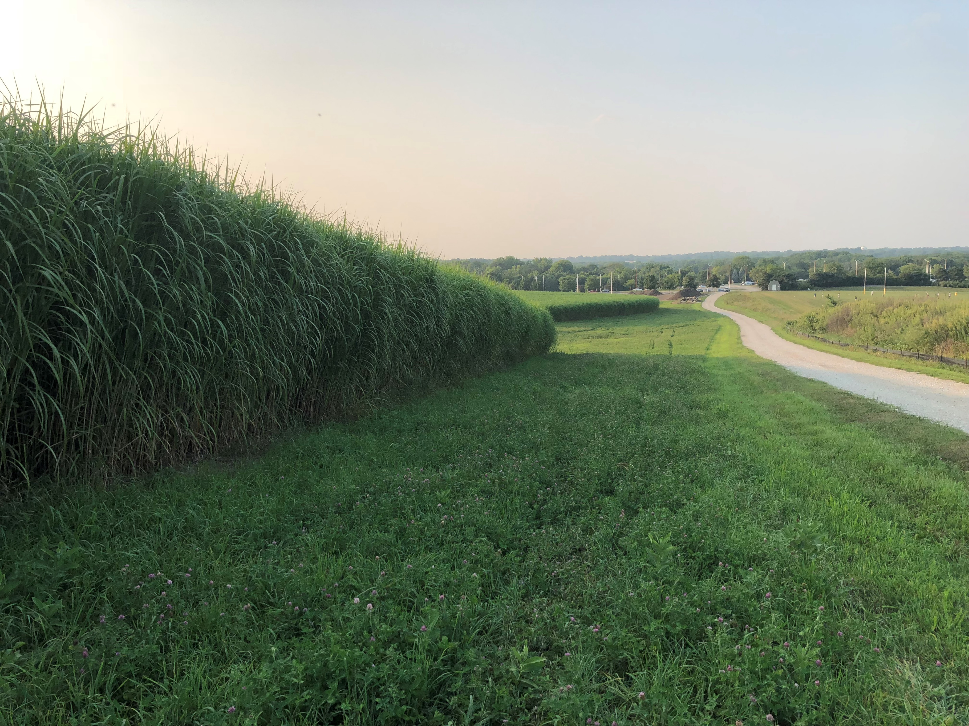
Real World Miscanthus provides great screening solutions for hunters and land managers all year long. Full of Green in the spring and summer. Rigid and strong through the entire winter.
Available at www.realworldwildlifeproducts.com Late December 2019.

Slide 12
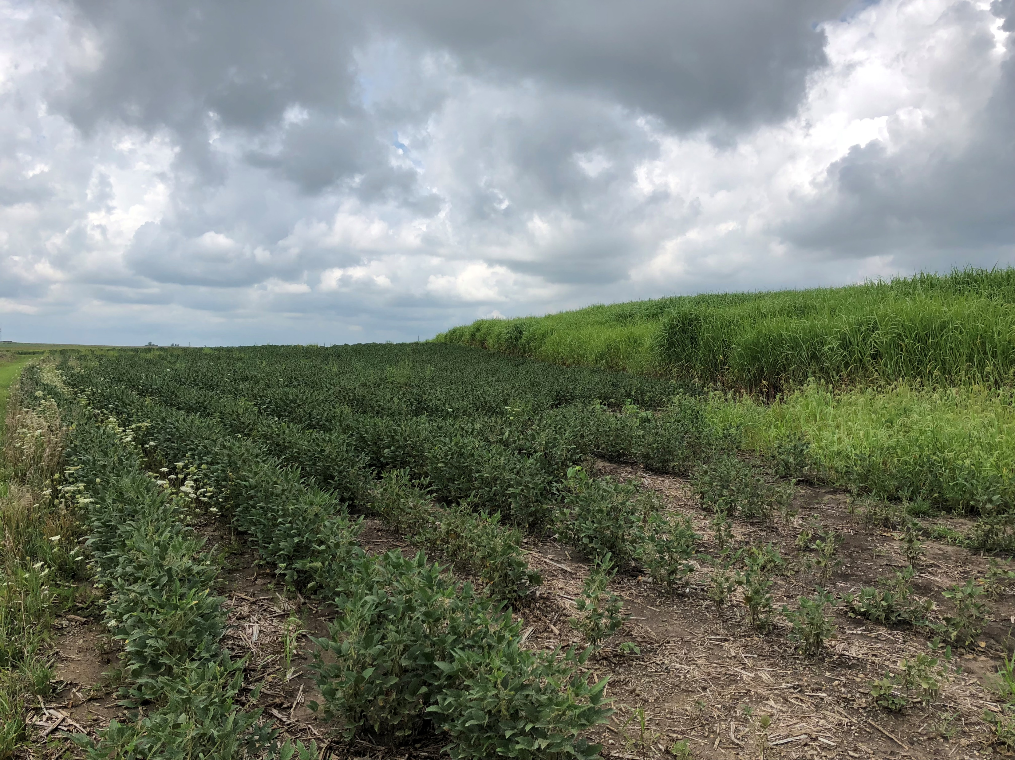
Real World Miscanthus provides boarders and security to your food plots. Make your deer feel more secure in your food plots for more day light activity.
Available at www.realworldwildlifeproducts.com Late December 2019.

Slide 13
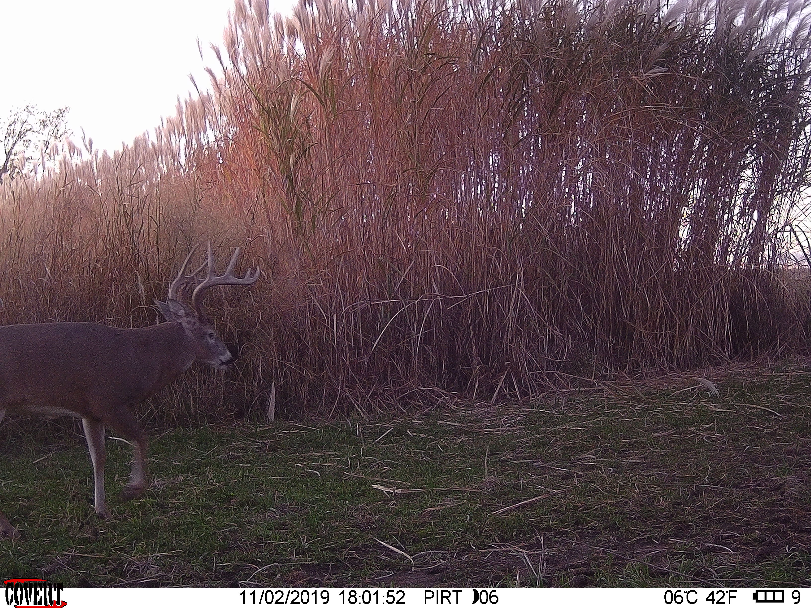
Real World Miscanthus provides hunters and land managers with a edge structure that can help create travel corridors and deer traffic.
Available at www.realworldwildlifeproducts.com Late December 2019.

Slide 14
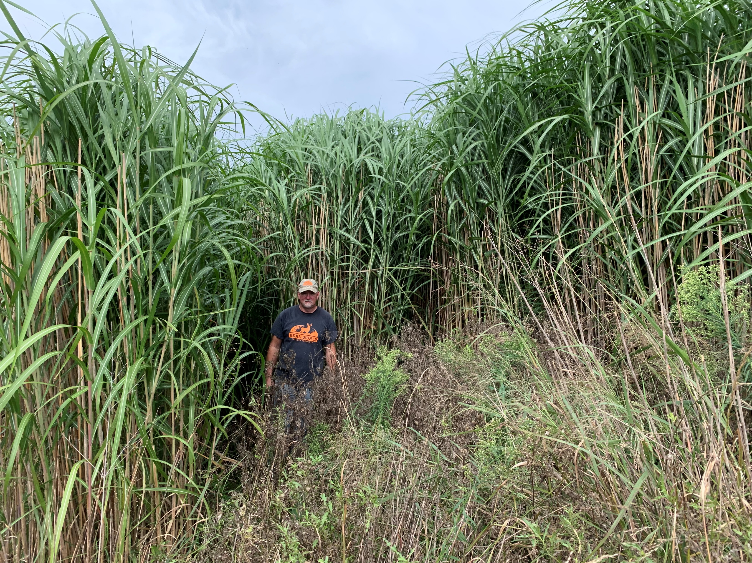
Real World Giant Miscanthus is the WALL THAT WON’T FALL! This leafy screen product creates the ultimate screen solution for hunters and land managers on properties big and small. Listen Episode #10 of the Podcast CHASING GIANTS with Don Higgins to hear how he uses this product on his hunting properties. Podcast can be found on every major podcast service
Available at www.realworldwildlifeproducts.com Late December 2019.

